Slide 1
Learning Feature Pyramids for Human Pose Estimation
Wei Yang, Shuang Li, Wanli Ouyang, Hongsheng Li, Xiaogang Wang
Paper Seminar
2020. 1. 13
Sunpil Kim
Chanwoo Yoon
국민대학교 HCI LAB

Slide 2
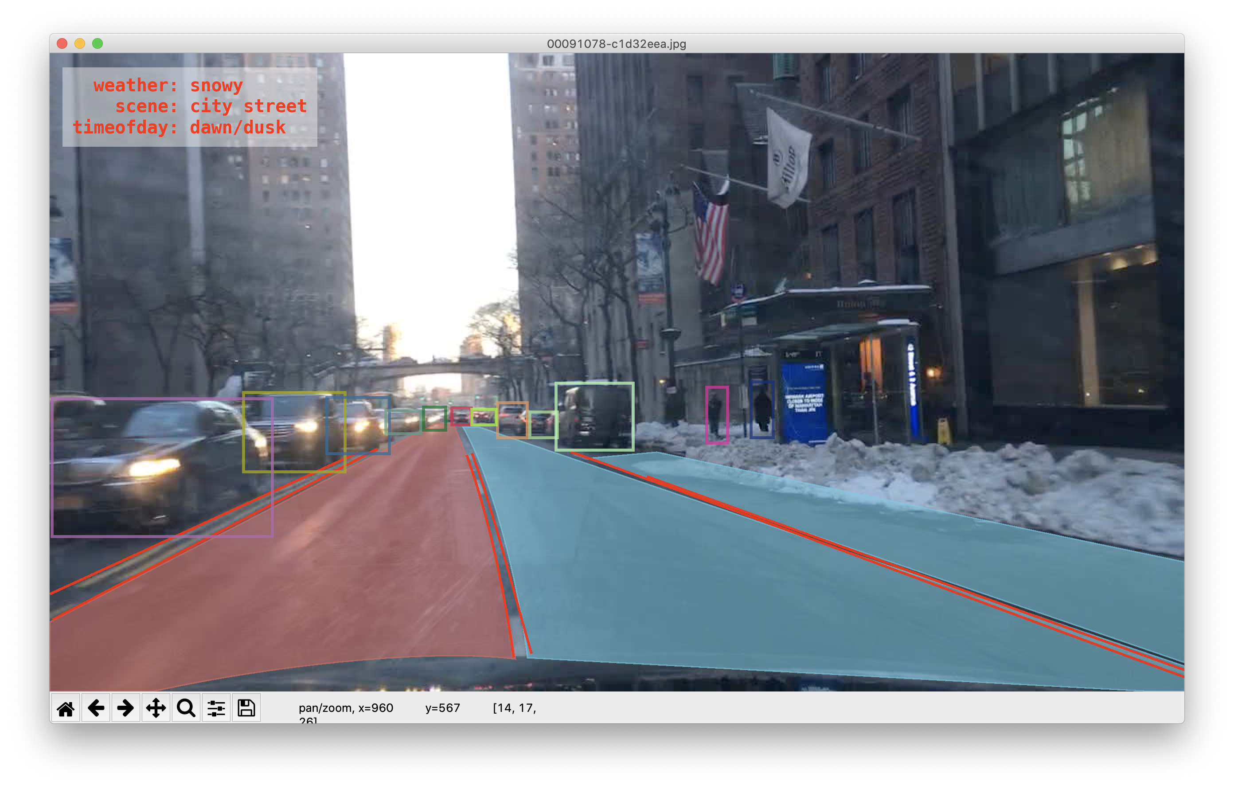
◆ Abstract
BDD100K(자율주행 Data Set)의 시각화
국민대학교 HCI LAB

Slide 3
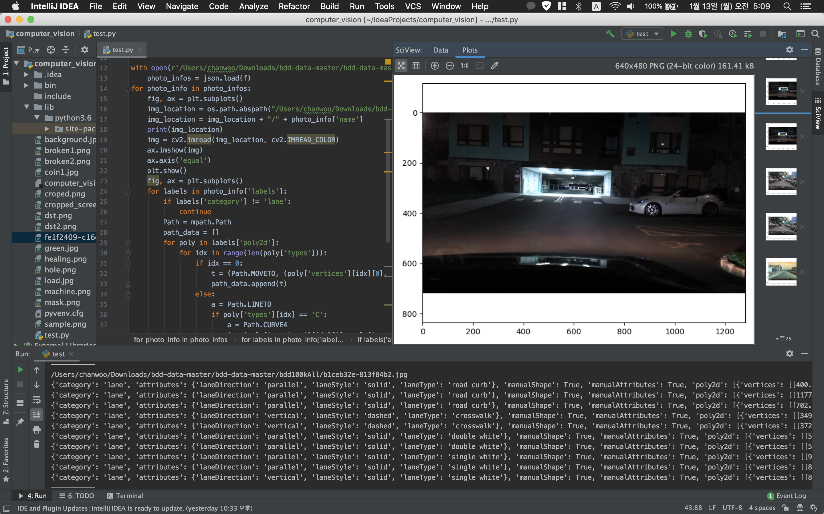
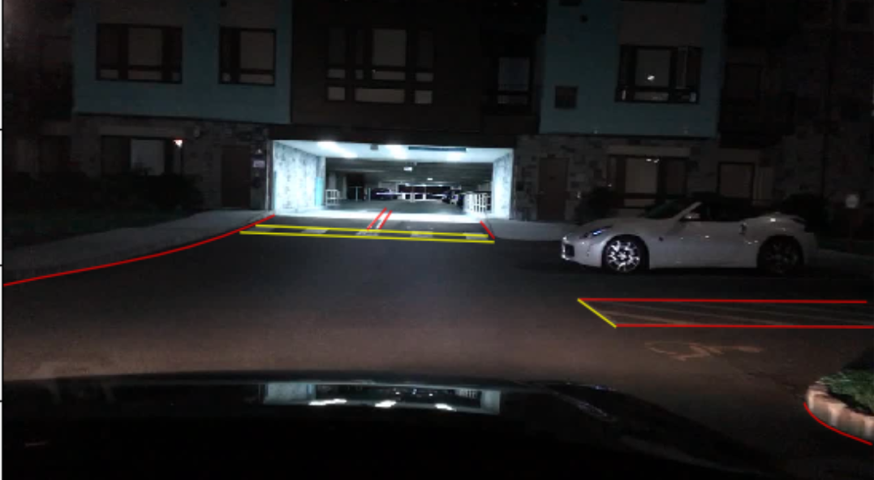
◆ Abstract
직접 Json포맷을 직접 추출 하여 정보와 라인 추출
국민대학교 HCI LAB

Slide 4
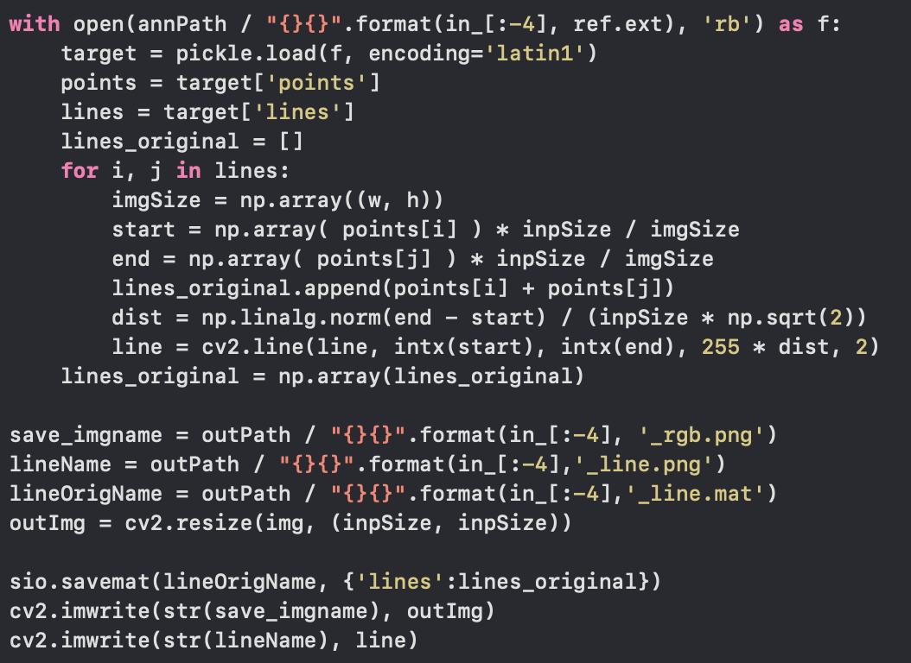
◆ Abstract
BDD100K(자율주행 Data Set)은 json포맷으로 데이터를 라벨링
Wireframe에서는 pickle포맷으로 데이터를 라벨링
국민대학교 HCI LAB

Slide 5
◆ Abstract
Design a PRM(Pyramid Residual Module) to enhance the invariance in scales of DCNNs
The PRM learn convolutional filters on various scales of input feature, which are obtained with different subsampling ratios in a multi branch network
Provide theoretic derivation to extend the current weight initialization scheme to multi-branch network structures
국민대학교 HCI LAB

Slide 6
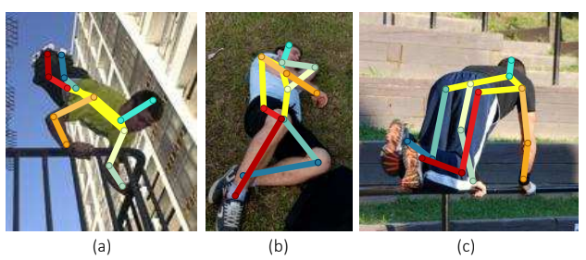
◆ Introduction
Scales for body parts may still be inconsistent due to inter-personal body shape variations caused by viewpoint change and body articulation
PRM obtains features of different scales
via subsampling, then convolution is us
ed to learn filters for features in different
scales
Problem of using residual units
: when outputs of two residual units are
summed up, the output variance is doubled.
국민대학교 HCI LAB

Slide 7
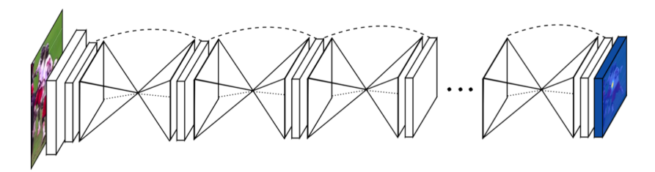
◆ Framework
Adopt the highly modularized stacked Hourglass Network as the basic structure
Hourglass network aims at capturing information at every scale
First, performs bottom-up processing by subsampling the feature maps
And conducts top-down processing by upsampling the feature maps with the combination of higher resolution features from bottom layers
Residual unit is used as the building block of the hourglass network
국민대학교 HCI LAB

Slide 8
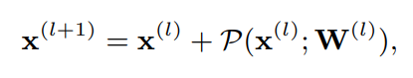
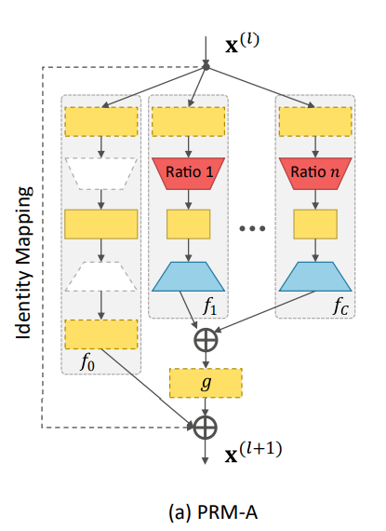
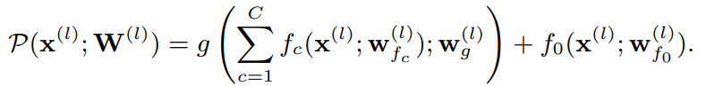
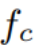
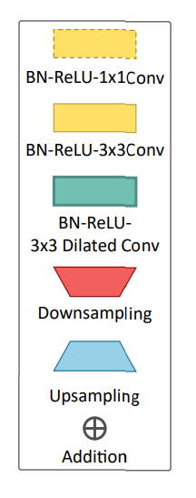
◆ Framework
Pyramid Residual Modules , which is able to learn multi-scale feature pyramids
l+1 layer input
l layer input
l layer filter
= set of parameters
is the transformation for the c-th pyramid level
국민대학교 HCI LAB

Slide 9
◆ Framework
Pyramid Residual Modules , which is able to learn multi-scale feature pyramids
Designed as a bottleneck structure to reduce the computational and space complexity
The feature dimension is reduced by 1x1 convolution
new features are computed on a set of subsampled input features by 3x3 convolutions
All new features are upsampled to the same dimension and are summed together
l+1 layer input
l layer input
l layer filter
= set of parameters
is the transformation for the c-th pyramid level
국민대학교 HCI LAB

Slide 10
Thank you
국민대학교 HCI LAB

